Slide 1
Error Detection and Correction for High Integrity Memory Systems
Limitations to Memory Reliability.
  Causes of Memory Failure.
Simple Error Detection Schemes – Parity.
Simple Error Detection and Correction Schemes - Hamming Codes.
  Single Bit Error Detect, Single Bit Error Correct Codes (SED/SEC).
  Double Bit Error Detect, Single Bit Error Correct Codes (DED/SEC).
  Implementation in Memory Systems.
(See also Wikipedia: ECC Memory)
©Paul Davies. Not to be copied, used, or revised without explicit written permission from the copyright owner.
This lecture may contain animations and is best viewed as a slide show

Slide 2
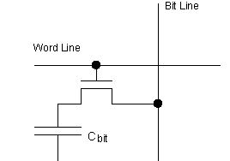
Transient Soft Errors in Dram Cells
We know that Dram is the main type of memory used in large, high availability, high reliability computer systems (e.g. servers).
However, a significant problem with DRAM cells is that they are not 100% reliable.
DRAM data is delicate, because it is maintained as a minute charge stored on a tiny capacitor. It doesn’t take much to upset the balance between a logic 1 and a logic 0.
This makes Drams susceptible to ‘transient’ or ‘soft’ errors where the data can become corrupted by unforeseen external influences (nothing to do with failing to refresh them or any faulty chip for example).
Such errors can occur as the result of external radiation striking the capacitor and dissipating the charge. Such soft errors do not damage the chip, since writing to it “fixes” the error.
Data Line
Cell Select
Cosmic Ray/Alpha particle
+
-
-
+
-
+
C_{bit}
-
-
-
-
-
-
0v
Cosmic Rays can destroy the charge stored on C_{bit} corrupting the data stored there

Slide 3
Soft errors can be a real problem in high availability, high integrity memory systems because they occur at unpredictable times and the failure is hard to replicate and pinpoint.
The hardware and software engineers often disappear on a “wild goose chase” trying to track down a bug in the software or the Dram controller which often isn’t the root cause of the problem.
Swapping dram chips doesn’t improve matters as the faults are not down to a physical defect in the chip, i.e. not due to wear and tear or manufacturing defects.
Rather, the failure is attributable to the use of tiny capacitors and is thus an inherent problem that designers of Dram have to live with.
Dram manufacturers have taken many steps to “harden” their Drams to shield them better, but the move to higher density (via smaller cells) and lower voltages has seen a rise in soft error rates not only for Dram, but for all memory technology.

Slide 4
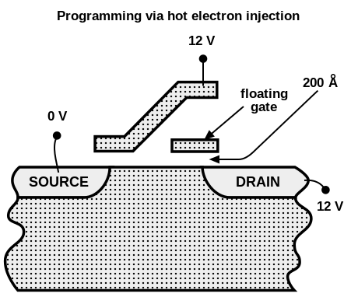
Transient Soft Errors in Flash Cells
As flash cells get smaller their cells also become susceptible to Cosmic rays striking the delicate charge on the floating gate.
Matters are made considerably worse with multi-level cell technology where 2, 3 or 4 bits of data are stored by precisely controlling the number of electrons stored on each floating gate.
Cosmic Ray/Alpha particle
- - - - - -
- - - - - -

Slide 5
Transient Soft Errors in Sram Cells
Even Sram cells at the smallest feature sizes and lowest operating voltages are becoming more susceptible. Cosmic rays can strike an interconnect wire (with it’s inherent capacitance), momentarily disrupting charge and voltage at that instant (Q = CV) which can lead to “bit-flips”.
https://link.springer.com/chapter/10.1007/978-1-4020-8363-1_6
https://www.eetimes.com/sram-soft-errors-cause-hard-network-problems/#
Cosmic Ray can strike charge on wire upsetting the voltages with the potential to cause bit flips
Cell Select
1
0
1
1 Bit Memory Cell Storing Logic 0
0
1
Data Out
Data Out

Slide 6
For your average Home PC, soft errors in Drams are not a significant problem, because data and programs tend not to be left lying around for long enough for the errors to occur or accumulate to the point where they become a problem.
This is because the memory in your home PC is forever being loaded with new data/programs, so soft errors, if they do arise, tend to be overwritten (and hence eliminated).
Note: those who put their PC into sleep mode when it's not in use are most likely to notice the problem.
In high availability systems, where servers run 24/7/365 and require 99.9999% availability, it can be a significant problem.
It’s estimated that a system with 1 GByte of RAM can expect a single soft error once every two weeks which may or may not lead to a crash. A hypothetical 1TByte memory system might experience a soft error every few minutes. (https://tezzaron.com/media/soft_errors_1_1_secure.pdf )

Slide 7
How do we deal with these problems?
  Design a memory controller that could detect faulty data read from memory and inform the CPU via some kind of hardware ‘exception’ - Simple and Cheap.
  Here, the controller does not try to correct the error, but simply informs the Operating System (via a CPU exception) that the access was unsafe. The application making the access will most likely be shut down.
  Detect and correct the error “on-the-fly” in hardware so that the system can continue operation - More complex and expensive but leads to increased reliability.
The choice boils down to cost and how important the integrity and availability of your system is.

Slide 8
Error Detection Schemes
Parity Checking

Slide 9
Single Bit Parity schemes have been around for years and are able to detect the occurrence of single bit errors (and in fact all errors where an odd number of bit errors have occurred) in each memory location,
Such a simple scheme cannot correct any of the errors since they cannot identify which bits were wrong.
Parity schemes only require one additional bit of storage within each memory location and is thus relatively cheap and easy to implement.
In the case of a byte wide memory system, such a scheme would require 9 bits of storage within each and every memory location, i.e.
8 bits to hold the data plus 1 for the parity bit.
This explains the existence of 9 bit wide memory chips.

Slide 10
Generating the Parity Bit Value: Odd or Even Parity
With a simple parity scheme, data written to each memory location is “tagged” with an additional Parity bit.
The choice of value to assign to that parity bit is up to the designer to chose. Two schemes exist
Even Parity Scheme
With even parity schemes, the extra parity bit is set to a value such that the total number of '1's stored in the memory location is an even number.
Odd Parity Scheme
With odd parity schemes, the extra parity bit is set to a value such that the total number of '1's stored in the memory location is an odd number.

Slide 11
Even Parity Bit Generation
To generate the Parity bit P for an even parity, byte wide memory system, we can simply add the 8 data bits together ignoring any carry.
The result (0 or 1) will be the value of the parity bit we store. This turns out to be the same as simply EXOR'ing the data bits b₀ – b₇.
You can see the effect of this in the truth table opposite for an EXOR gate. When you take
2 bits A, B and EXOR them (to generate the parity) the number of resulting 1’s is always even.
The resulting parity bit is stored alongside the data bits as the 9th bit in that location.
For Odd Parity schemes, we simple invert the even parity bit.
EXOR Gate Truth Table
A B Parity Bit
0 0 0
0 1 1
1 0 1
1 1 0
Total number of bits (A,B,P) that are logic 1 is always an EVEN number

Slide 12
Example 8 bit Data : [10111010] (Number of '1’s in this data = 5)
For an even parity scheme, P will be set to 1, resulting in the stored word (data plus parity) containing 6 logic '1’s, i.e. an even number of logic 1’s.
For an odd parity scheme, P will be set to 0, resulting in the stored word containing 5 logic '1’s i.e. an odd number of logic '1's
Data
b₇b₆b₅b₄b₃b₂b₁b₀
+
Parity Bit (odd)
Parity Bit (even)
[ 1 + 0 + 1 + 1 + 1 + 0 + 1 + 0 + 0 ]
[ 1 + 0 + 1 + 1 + 1 + 0 + 1 + 0 + 1 ]
With ODD parity systems, an odd number of 1’s is stored (here = 5)
With EVEN parity systems, an even number of 1’s is stored (here = 6)

Slide 13
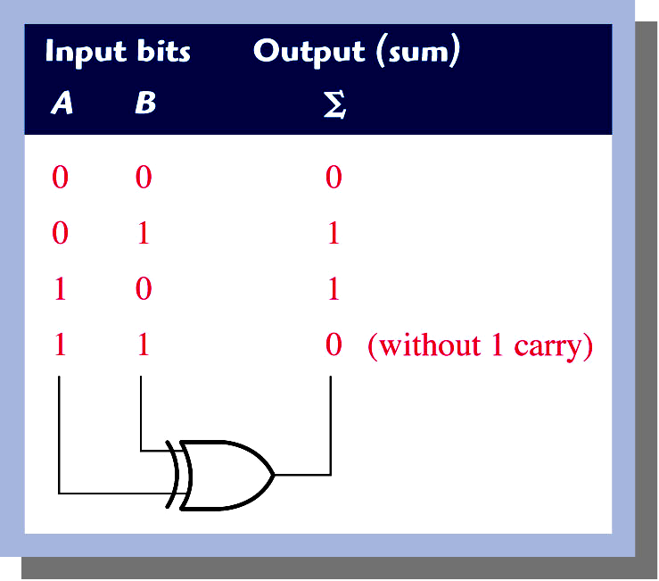
Simple Even Parity Bit Generator (for 8 bit data)
D₀
0
1
D₁
1
D₂
1
0
1
D₃
1
0
Even Parity Bit
D₄
1
1
D₅
0
1
D₆
0
0
D₇
0
Parity Bit = 0 when number of ‘1’s at inputs D₀ – D₇ is EVEN
Parity Bit = 1 when number of ‘1’s at inputs D₀ – D₇ is ODD.
Grouping data bits and parity bit together will make total number of 1’s in that grouping an EVEN number.

Slide 14
Simple Even Bit Parity Calculation Problem
Generate the value of the Even Parity bit for the following two items of 12 Bit Data:-
  [101101001110]
  [010110010101]
Two Solutions:
Add up the data bits in binary (ignoring any carry), or EXOR them and the result is the value of the Parity Bit to be stored alongside the data.
Alternatively, count the number of 1’s in the data bits and assign a value to the Parity Bit such that the total number of 1’s stored is an even number.
  [101101001110] Parity bit = 1
  [010110010101] Parity bit = 0

Slide 15
Detecting an Error During a Read Operation: Check Bit Calculation
When the whole word is later read back and all the bits (8 bit data + parity bit) are EX-OR’ed together, the result (a check bit) should always be 0 if no error occurred.
If any single bit of data (including the parity bit itself) has been corrupted, the calculated check bit will be 1 (indicating an error).
Note that any odd number of bit errors (1,3,5 etc.) will result in a check bit = 1, but any even number of bit errors (2,4,6 etc.) will not be detected at all, since it causes a double flipping of the check bit.
Data (9 bits) read correctly
1 0 1 1 1 0 1 0 1
+
check bit = 0
NO ERROR

Slide 16
Simple Check Bit Generator for Even Parity (and 8 bit data)
D₀
0
1
D₁
1
Receiver’s calculated Parity bit
D₂
1
0
1
D₃
1
Received Data
0
0
D₄
1
1
D₅
0
1
Check Bit
D₆
0
‘1’ means Error
‘0’ means No Error
0
D₇
0
Received
Parity Bit
P
0
Data and Parity Bit Read Correctly: Check Bit = 0

Slide 17
Example Single Bit Error Detection with Even Parity
Suppose we read back the following 9 bit data word, where the data bit d₃ has been corrupted (from a 1 to a 0).
  [10110010 | 1 ] (data was originally 10111010 | 1)
The result of EX-OR’ ing these 9 bits to produce the check bit, would result in a logic 1, i.e. an error.
1 0 1 1 0 0 1 0 1
+
check bit = 1
ERROR !!

Slide 18
Illustration of Single Bit Error in Read Data
D₀
0
1
D₁
1
0
Receiver’s calculated Parity bit
D₂
1
1
D₃
0
Received Data
1
1
D₄
1
1
D₅
0
1
Check Bit
D₆
0
‘1’ means Error
‘0’ means No Error
0
D₇
0
Received
Parity Bit
P
0
Single Bit Data or Parity Error: Check Bit = 1
Result is same for any odd number of bit errors

Slide 19
Example Double Bit Error (Even Parity)
Suppose instead that we read back the following 9 bit data word both data bits d₃ and d₄ have been corrupted.
  [10100010 | 1 ] ( data was originally 10111010 | 1 )
The result of EX-OR’ ing these 9 bits would now be a logic 0, (no error)
Note that even with single bit errors, this simple 1-bit parity scheme cannot identify the location of any erroneous bits and thus it cannot be used to as a means of correcting any faulty data. It can only “flag” an error.
1 0 1 0 0 0 0 1 1
+
check bit = 0
FALSE NEGATIVE !!

Slide 20
Illustration of Double Bit Error in Read Data
D₀
0
1
D₁
1
0
Receiver’s calculated Parity bit
D₂
1
1
D₃
0
Received Data
0
0
D₄
0
0
D₅
0
0
Check Bit
D₆
0
‘1’ means Error
‘0’ means No Error
0
D₇
0
Received
Parity Bit
P
0
Double Bit Data or Parity Error: Check Bit = 0
Result is same for any even number of bit errors

Slide 21
Single Bit
Error Detection,
Single Bit
Error Correction
(SED/SEC)
Schemes

Slide 22
We saw with the simple Parity scheme that any single bit error leads to a flipping of the receiver’s calculated check bit from a 0 (meaning no error) to a 1 (an error). In addition, a double bit error leads to a double check bit flip implying no error at the receiver. Both concepts are important for what comes next on error correction.
Depending upon the chosen level of sophistication, use of Hamming Codes will enable a memory controller to detect and correct single-bit errors within each ‘N’ bit wide memory location.
Such a scheme can impose significant additional storage requirements leading to increased cost and complexity.
Example
by storing an additional 4 bits of Hamming code data, alongside every byte of data, (i.e. a 12 bit wide memory system), we could identify and correct all single bit errors arising within that location, including errors occurring in the hamming code bits themselves.
The more sophisticated the hamming code scheme, the more erroneous bits can be detected and corrected but at a tradeoff of much increased memory cost and a more sophisticated memory controller (how much is increased reliability worth?)

Slide 23
Error Correcting Techniques: Hamming Codes
Basic Error Correcting techniques in memory systems borrow concepts from Digital Communications theory.
The idea is based on Forward Error Codes (F.E.C.s), where multiple Parity bits are encoded into a data stream and transmitted as a Code Word. That is, a code word consisting of [Data Bits + Multiple Parity Bits]
F.E.C.’s are essentially, carefully chosen parity bits that when flipped by an error can identify the location of any single bit error (data or parity) in the resultant code word. Hardware could use these extra parity bits to identify and correct errors as the code word is read.
The table opposite highlights the number of parity bits required for a specified data width to enable single bit error detection and single bit error correction (i.e. SED/SEC).
As you can see this scheme becomes more cost effective with wider data.
Data Width # of Parity Bits
4 3
8 4
12 5
16 5
20 5
24 5
28 6
32 6
64 7
etc
7 parity bits required to detect and correct single bit errors in 64 bit wide data.

Slide 24
In communications, where the data is transmitted serially, the extra Parity Bits are transmitted in bit positions corresponding to powers of 2, i.e. bit positions 1, 2, 4, 8, 16, 32 etc.
The significance of this, as well as counting from position 1 (not 0) will become clear shortly.
Example Parity Bit Calculation for 4 Bit Data
We generate the values for the 3 parity bits p₀, p₁ and p₂ according to the equations below.
During a read, EX-OR'ing the data and the parity bits together in the same way should produce three check bits, all = 0 if no errors have occurred.
Code Word Bit Position
7 6 5 4 3 2 1
d₃ d₂ d₁ p₂ d₀ p₁ p₀
Data bits occupy positions that are NOT powers of 2, i.e. positions 3, 5, 6, 7, 9, 10 etc.
Parity bits placed in positions that ARE powers of 2, until all data bits have been placed.
As were saw with simple parity scheme, each check bit will be 0 if there are no bit errors (either in the data or the parity bits)
  Writing p₀ = d₀ + d₁ + d₃ Reading c₀ = p₀ + d₀ + d₁ + d₃ = 0
  Writing p₁ = d₀ + d₂ + d₃ Reading c₁ = p₁ + d₀ + d₂ + d₃ = 0
  Writing p₂ = d₁ + d₂ + d₃ Reading c₂ = p₂ + d₁ + d₂ + d₃ = 0

Slide 25
7 6 5 4 3 2 1
d₃ d₂ d₁ p₂ d₀ p₁ p₀
How do we determine the Parity Equations?
We’ll explain the theory later, but for now, to demonstrate, we simply write out in binary the position numbers occupied by the data bits, i.e. positions 3, 5, 6, 7 etc.
d0 occupies position 3 = 011
d1 occupies position 5 = 101
d2 occupies position 6 = 110
d3 occupies position 7 = 111
Next we identify all those position numbers where there is a ‘1’ in the least significant bit of their position number (column 0). These indicate the positions of the data bits that have to be EX-OR’ed to produce parity bit p0.
Now identify all those position numbers where there is a ‘1’ in column 1. These indicate the positions of the data bits that have to be EX-OR’ed, to produce parity bit p0.
Repeat until all columns and parity equations generated.
Positions 3, 6, 7 when written in binary have a ‘1’ in column 1
Positions 3, 5, 7 when written in binary have a ‘1’ in column 0
011 = 3 d₀
101 = 5 d₁
11 1 = 7 d₃
011 = 3 d₀
110 = 6 d₂
111 = 7 d₃
101 = 5 d₁
110 = 6 d₂
111 = 7 d₃
p₀
p₁
p₂
Positions 5, 6, 7 when written in binary have a ‘1’ in column 2

Slide 26
In Summary
p0 = EXOR of data bits d0, d1 and d3.
p1 = EXOR of data bits d0, d2 and d3
p2 = EXOR of data bits d1, d2 and d3
How does this help?
When we read back the data and the previously stored parity bits and EXOR them all together (like we did for the simple parity scheme) to create a 3 bit checksum, the checksum will be [000] if there were no errors.
Any other check bit value will indicate the existence of a single bit error and more importantly the location of that erroneous bit, even if it occurred in the parity bit itself. We’ll see that demonstrated shortly.
011 = 3 d₀
101 = 5 d₁
111 = 7 d₃
011 = 3 d₀
110 = 6 d₂
111 = 7 d₃
101 = 5 d₁
110 = 6 d₂
111 = 7 d₃
p₀
+
p₁
+
p₂
+

Slide 27
Classroom Problem 1
How many Parity Bits would be required to enable correction of a single bit error in an 8 bit data word? What positions would the parity and data bits occupy in the code word?
Solution
First construct the code word as follows placing parity bits at positions in the code word corresponding to powers of two, until you have placed all data bits.
12 11 10 9 8 7 6 5 4 3 2 1
d₇ d₆ d₅ d₄ p₃ d₃ d₂ d₁ p₂ d₀ p₁ p₀
Solution: 4 Parity Bits in positions 1, 2, 4, 8

Slide 28
Classroom Problem 2
Write down the parity equations for an 8 bit data word.
First write out in binary the position numbers occupied by the Data Bits in the code word, then look for 1’s in the columns.
  3 0011 d0
  5 0101 d1
  6 0110 d2
  7 0111 d3
  9 1001 d4
  10 1010 d5
  11 1011 d6
  12 1100 d7
P0 = EXOR of data bits d0, d1, d3, d4, d6
P1 = EXOR of data bits d0, d2, d3, d5, d6
P2 = EXOR of data bits d1, d2, d3, d7
P3 = EXOR of data bits d4, d5, d6, d7

Slide 29
Demonstration
Generating Parity bits for
4 bit data

Slide 30
Consider the example 4 bit data word d₃, d₂, d₁, d₀ = [1011].
We calculate the parity bits according to the equations developed earlier.
  p₀ = d₀ + d₁ + d₃
  p₁ = d₀ + d₂ + d₃
  p₂ = d₁ + d₂ + d₃
We generate each parity bit’s value thus
  p₀ = 1 + 1 + 1 i.e. p₀ = 1
  p₁ = 1 + 0 + 1 i.e. p₁ = 0
  p₂ = 1 + 0 + 1 i.e. p₂ = 0
These 3 parity bits are stored such that the resultant code word (data and parity) would look like this if transmitted serially:-
  d₃ d₂ d₁ p₂ d₀ p₁ p₀ = [1 0 1 0 1 0 1]

Slide 31
Generating
Check bits for
4 bit data

Slide 32
We calculate the set of check bits using the original equations that were used to create the parity bits in the first instance. For example, assuming the correctly generated code word shown again below.
d₃ d₂ d₁ p₂ d₀ p₁ p₀ = [1 0 1 0 1 0 1]
We calculate check bit C₀ as the EXOR of p0 plus the data bits that were originally used to generate p0 in the first place, likewise for check bits C₁, C₂ etc. Thus
  C₀ = p₀ + d₀ + d₁ + d₃ C₀ = 1 + 1 + 1 + 1 = 0
  C₁ = p₁ + d₀ + d₂ + d₃ C₁ = 0 + 1 + 0 + 1 = 0
  C₂ = p₂ + d₁ + d₂ + d₃ C₂ = 0 + 1 + 0 + 1 = 0
If the Data and Parity Bits (i.e. the code word stored) were read correctly then each of the resultant check bits will be 0, (as we can see above, indicating no corruption of data or parity bits has taken place).
Each check bit will be 0 when there are no errors

Slide 33
Introducing a
Single Bit Error

Slide 34
Suppose an error did occur some time in the future and that instead of reading back the code word that was stored (repeated again below)
  d₃ d₂ d₁ p₂ d₀ p₁ p₀ = [1 0 1 0 1 0 1]
we actually read back a code word with an error in d₂ (i.e. bit position 6) thus we actually read back :-
  d₃ d₂ d₁ p₂ d₀ p₁ p₀ = [1 1 1 0 1 0 1]
Error in bit position 6 causing a '0' to be read back as a '1'

Slide 35
How do we detect and locat the source of the error?
Calculate the set of check bits by EXOR'ing the data bits we read back with the parity bits according to the original parity bit encoding equations.
  C₀ = p₀ + d₀ + d₁ + d₃
  C₁ = p₁ + d₀ + d₂ + d₃
  C₂ = p₂ + d₁ + d₂ + d₃
In this example we end up with the 3 bit checksum [110] = 6
  C₀ = 1 + 1 + 1 + 1 = 0
  C₁ = 0 + 1 + 1 + 1 = 1
  C₂ = 0 + 1 + 1 + 1 = 1
This just so happens to identify the bit position which was in error and thus it can be corrected ‘on-the-fly’ by inverting data bit d₂ in position 6, in hardware, during the read.
Value = 6 [110] highlighting d₂ is wrong

Slide 36
What if the error lies with one of the Parity Bits?
If one of the parity bits is erroneous then it only affects/flips one single check bit (see below) and thus the only resulting check bit values are
[001], [010] or [100] corresponding to bit positions 1, 2 or 4 which correspond exactly to the positions occupied by the parity bits in the code word (i.e. positions that are powers of 2).
This is why the data and parity bits are stored in position numbers which are powers of 2 and why the bit positions in the code word start off at position 1 not 0 (a set of check bits = 000 means no error and thus 0 cannot be used as an erroneous position number).
  C₀ = p₀ + d₀ + d₁ + d₃
  C₁ = p₁ + d₀ + d₂ + d₃
  C₂ = p₂ + d₁ + d₂ + d₃
An error in a parity bit flips exactly one check bit leading to check bit values of [001], [010] or [100], i.e. positions 1, 2 or 4 where the parity bits are stored.

Slide 37
Classroom Exercise
The following 6 bits of data are to be stored [ 101101 ]
Calculate the Parity bits and construct the code word for this data.
We know from the previous example that 4 parity bits are needed for 6 bits of data in accordance with the equation and code word format below
P₀ = EXOR of data bits occupying positions? 3, 5, 7, 9, i.e. d₀, d₁, d₃, d₄
P₁ = EXOR of data bits occupying positions? 3, 6, 7, 10 i.e. d₀, d₂, d₃, d₅
P₂ = EXOR of data bits occupying positions? 5, 6, 7 i.e. d₁, d₂, d₃
P₃ = EXOR of data bits occupying positions? 9, 10 i.e. d₄, d₅
10 9 8 7 6 5 4 3 2 1
d₅ d₄ p₃ d₃ d₂ d₁ p₂ d₀ p₁ p₀
d₅ d₄ p₃ d₃ d₂ d₁ p₂ d₀ p₁ p₀
1 0 ? 1 1 0 ? 1 ? ?

Slide 38
Solution
Classroom Exercise
Now introduce an error into data bit d₃ (bit position 7) and calculate the check bits based on what is read back. Can you detect where the error is?
C₀ = EXOR of p₀, d₀, d₁, d₃, d₄
C₁ = EXOR of p₁, d₀, d₂, d₃, d₅
C₂ = EXOR of p₂, d₁, d₂, d₃
C₃ = EXOR of p₃, d₄, d₅
d₅ d₄ p₃ d₃ d₂ d₁ p₂ d₀ p₁ p₀
1 0 1 1 1 0 0 1 0 0
d₅ d₄ p₃ d₃ d₂ d₁ p₂ d₀ p₁ p₀
1 0 1 0 1 0 0 1 0 0
= EXOR of 0,1,0,0,0 = 1
= EXOR of 0,1,0,1,1 = 1
= EXOR of 0,0,0,1 = 1
= EXOR of 1,0,1 = 0
7

Slide 39
How does this
“Magic” work?

Slide 40
Take a look at the 4 bit check sum equations shown again below
  C₀ = p₀ + d₀ + d₁ + d₃
  C₁ = p₁ + d₀ + d₂ + d₃
  C₂ = p₂ + d₁ + d₂ + d₃
From this, we see that if any single bit is corrupted, it will invert/flip any check bit for which the corrupted bit is part of the equation.
For example, if d₁ were corrupted, then check bits C₂ and C₀ would be flipped to logic 1 and C₁ would remain at logic 0. Therefore the check bits would be {101} identifying bit position 5 (i.e. d₁) as the faulty bit.
7 6 5 4 3 2 1
d₃ d₂ d₁ p₂ d₀ p₁ p₀

Slide 41
The apparent “magic” with this scheme is in choosing the parity equations so that a faulty bit affects the check bits in just such a way as to identify that faulty bit’s location.
For example, if we are going to detect a fault in data bit d₃ (code word position 7), then we have to ensure that all three check bits get flipped to 1 when d₃ gets corrupted/flipped. This will ensure that the checksum = [111] = 7₁₀ and thus identify d₃ as the source of the error.
This is why d₃ is part of the parity and check bit equations for
C₀, C₁ and C₂
Likewise an error in d₀ (code word position 3) would have to generate the resultant check bits = [011] to identify location 3 as the source of the error. That is why it is part of the parity and check bit equations for C₀ and C₁ but not C₂.
The way the parity equations were written on page 25 is just a reflection of this “observation”. That is c₀ needs to be 1, i.e. [xx1] to indicate any error in position 3, 5 or 7, i.e. [011], [101] and [111], that is why it is formed as the EXOR of data in those positions.

Slide 42
Example: Given the following 12 bit wide data
Where do the parity bits and data bits go
17 16 15 14 13 12 11 10 9 8 7 6 5 4 3 2 1
d₁₁ p₄ d₁₀ d₉ d₈ d₇ d₆ d₅ d₄ p₃ d₃ d₂ d₁ p₂ d₀ p₁ p₀
Example: What are the parity equations for p_{0,} p_{1,} p_{2 ,} p₃ and p₄?
p₀ must be flipped for any single bit error occurring in positions
3, 5, 7, 9, 11, 13, 15, 17 so that column 0 check bit = [xxxx1]
EXOR: d₀, d₁, d₃, d₄, d₆, d₈, d₁₀, d₁₁
p₁ must be flipped for any single bit error occurring in positions
3, 6, 7, 10, 11, 14, 15 so that column 1 check bit = [xxx1x]
EXOR: d₀, d₂, d₃, d₅, d₆, d₉, d₁₀
p₂ must be flipped for any single bit error occurring in positions
5, 6, 7, 12, 13, 14, 15 so that column 2 check bit = [xx1xx]
EXOR: d₁, d₂, d₃, d₇, d₈, d₉, d₁₀
p₃ must be flipped for any single bit error occurring in positions
9, 10, 11, 12, 13, 14, 15 so that column 3 check bit = [x1xxx]
EXOR: d₄, d₅, d₆, d₇, d₈, d₉
p₄ must be flipped for any single bit error occurring in position
17 so that so that column 4 check bit = [1xxxx]
JUST: d₁₁
Data bit positions
00000 0
00011 3
00101 5
00110 6
00111 7
01001 9
01010 10
01011 11
01100 12
01101 13
01110 14
01111 15
10001 17
Note: We don’t include positions occupied by the parity bits when calculating the parity bits i.e. #1,2,4,8,16

Slide 43
What if we had a
Double Bit
Error?

Slide 44
What happens to the check bits if two bit errors occur?
The check bits can only identify one position number, so there is no way they could be used to identify the position of 2 incorrect bits.
However, look at the equations again. If a double bit error were to occur in say d₀ and d₁ (positions 3 and 5) what position would this indicate as incorrect?
c₀ would be double flipped (no effect) but c₁ and c₂ would be single flipped identifying position 6. This is obviously incorrect. We'd end up correcting the wrong bit (now we’d have 3 bit errors) and not realise that we still had a problem.
  c₀ = p₀ + d₀ + d₁ + d₃
  c₁ = p₁ + d₀ + d₂ + d₃
  c₂ = p₂ + d₁ + d₂ + d₃

Slide 45
An ECC circuit that could be integrated into a Dram Controller

Slide 46
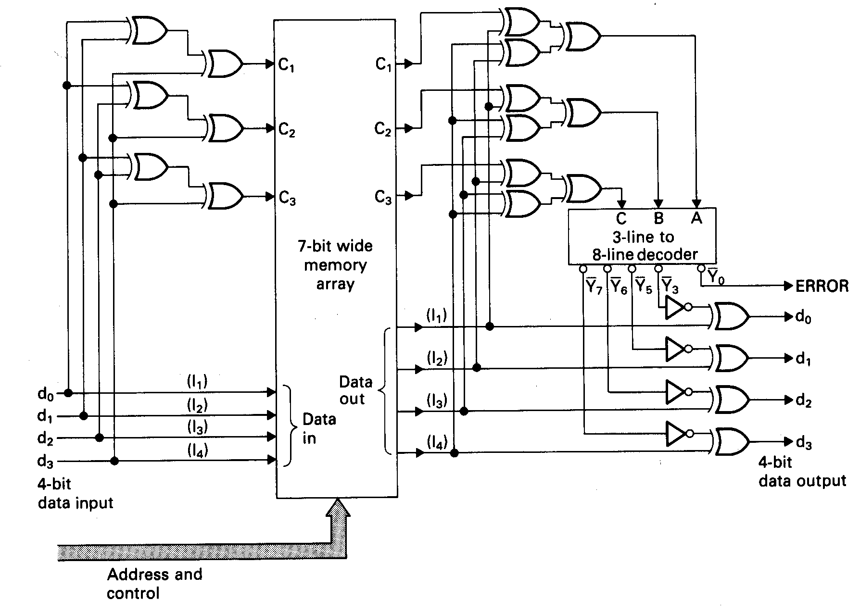
Note that we do not have to store the data bits in memory at bit positions corresponding to powers of 2 since this is NOT serial communications
p0 = EXOR of d0,d1,d3
p1 = EXOR of d0,d2,d3
p2 = EXOR of d1,d2,d3
c0 = EXOR of p0,d0,d1,d3
c1 = EXOR of p1,d0,d2,d3
c2 = EXOR of p2,d1,d2,d3
c0
Decoder produces 1 of 8 active low outputs. All others high
p0
p0
p0
p0
c1
p1
p1
p1
p1
When the 3 check bits c0, c1, c2 = 000 the active high ERROR signal is 0 (i.e. no error)
c2
p2
p2
p2
p2
d0
d1
4-bit corrected data read by CPU
d0
d2
d1
d2
d3
d3
4-bit Data to be written
1 active low (0) output of decoder produced to identify the single data bit error and flip that data bit via a ‘1’ into an EXOR gate (parity bits don’t have to be flipped)

Slide 47
Double Bit
Error Detection,
Single Bit
Error Correction
(DED/SEC)
Schemes

Slide 48
With the simple addition of an extra parity bit we could enhance the scheme to include the detection (but not correction) of double bit errors.
For a byte wide data scheme, the extra parity bit (P₄) is generated as the EXOR of the original 8 data bits and the other 4 parity bits P₀ – P₃
Data
Parity Bits P₀ – P₃
b₇b₆b₅b₄b₃b₂b₁b₀ P₀P₁P₂P₃
+
P₄ = EXOR of Data and other Parity Bits

Slide 49
Double Bit Error Detection: What happens during reading?
During reading, we calculate the same 4 check bits C₀ - C₃ using the same equations we had before.
We calculate an extra/new check bit C₄ as the EXOR of the 8 data bits and the 5 parity bits (P₀ – P₄) READ BACK FROM MEMORY.
Provided no errors have occurred, the check bits should be {00000}.

Slide 50
What is the value of C₄ if an error occurs during a Read?
If any single bit error occurs during the read, C₄ will always be flipped to 1 regardless of where that error lies (data or parity).
If a double bit error occurs, C₄ will be double flipped back to 0 but the other check bits will be non-zero. Their value should be treated as garbage as we saw previously on Page 44, since double bit errors are not correctable using this scheme.
Data
Parity Bits P₀ – P₃
b₇b₆b₅b₄b₃b₂b₁b₀ P₀P₁P₂P₃P₄
5th Parity Bit P₄
+
C₄ = EXOR of Data plus other Parity Bits
Any single bit error read back from memory will cause C₄ to flip to 1, a double bit error cause C₄ to double flip back to 0

Slide 51
Interpreting the results
If C₄ = 0 and C₀ - C₃ is [0000], then no errors have occurred and no correction is required.
If C₄ = 0 and C₀ – C₃ is not [0000], then a double bit, non-correctable error has occurred i.e. no bits can be corrected and it is an unrecoverable error.
  If C₄ = 1 and C₀ – C₃ is [0000] then only a single bit error has occurred in Parity Bit P₄. The data itself and other parity bits are correct and no correction of the data is required.
  If C₄ = 1 and C₀ – C₃ is not [0000], then a single bit error has occurred in the bit position indicated by C₀ – C₃ and it can be corrected.
  This also identifies any single bit parity errors in bits P₀ – P₃ which can be ignored.

Slide 52
Example DED/SEC Parity Encoding with a 4 bit Data Word
Take the 4 bit data word d₃, d₂, d₁, d₀ = [1011]. We calculate the parity bits according to the equations developed earlier.
  p₀ = d₀ + d₁ + d₃
  p₁ = d₀ + d₂ + d₃
  p₂ = d₁ + d₂ + d₃
We generate each parity bit thus
  p₀ = 1 + 1 + 1 i.e. p₀ = 1
  p₁ = 1 + 0 + 1 i.e. p₁ = 0
  p₂ = 1 + 0 + 1 i.e. p₂ = 0
Extra Parity bit p₃ = EXOR { p₀, p₁, p₂, d₀, d₁, d₂, d₃ } = 0, thus the code word is
  p₃ d₃ d₂ d₁ p₂ d₀ p₁ p₀ = [ 0 1 0 1 0 1 0 1 ]
p₃ is the extra parity bit
appended last (not
necessarily in a power
of 2 position)

Slide 53
Proof of Result 4
What happens if a single bit error occurs in say data bit d₃.
A single bit error causes the extra check bit C₃ to be flipped to 1 since
  C₃ = EXOR { p₀, p₁, p₂, p₃, d₀, d₁, d₂, d₃ } = 1
  p₃ d₃ d₂ d₁ p₂ d₀ p₁ p₀ = [ 0 0 0 1 0 1 0 1 ]
However, d₃ is part of the equations for the 3 other check bits, hence
C₂, C₁, C₀ will be flipped to {111}.
This means we have a single bit correctable error in position 7, i.e. d₃. (See Rule 4 - Page 51)

Slide 54
Proof of Result 3
Assume a single bit error in the extra parity bit P_{3.} The code word reads as
The only check bit affected by an error in P₃ is C₃ because no other check bits use P₃ in their equation, thus the computed value of the check bit C₃ will be
  C₃ = EXOR { p₀, p₁, p₂, p₃, d₀, d₁, d₂, d₃ } = 1
The remaining check bits C₀- C₂ will be [000]
(since P₃ is not part of the equation for those check bits).
This indicates that a single bit error has occurred in P₃ and the data was read correctly. (See Rule 3 - Page 51)
  p₃ d₃ d₂ d₁ p₂ d₀ p₁ p₀ = [ 1 1 0 1 0 1 0 1 ]

Slide 55
Proof of Result 2
Let’s introduce a double bit error for example in bits d₃ and p₀
This double bit error will cause the extra check bit C₃ to be double flipped to logic 0 since d₃ and p₀ are part of its equation.
  C₃ = EXOR { p₀, p₁, p₂, p₃, d₀, d₁, d₂, d₃ } = 0
However, d₃ (in position 7) is also part of the equations for the check bits
C₂, C₁, C₀ , causing them to the flipped, but because p₀ is in error, C₀ will be double flipped (as p₀ and d₃ are both part of its equation) so the position of the error is indicated as {110}, incorrectly identifying position 6 as the source of the error.
However this does not matter, since our circuitry will detect this is a double bit, non-correctable error (C₃ = 0, C₂ – C₀ = non-zero). (Rule 2 - Page 51)
  p₃ d₃ d₂ d₁ p₂ d₀ p₁ p₀ = [ 0 0 0 1 0 1 0 0 ]

Slide 56
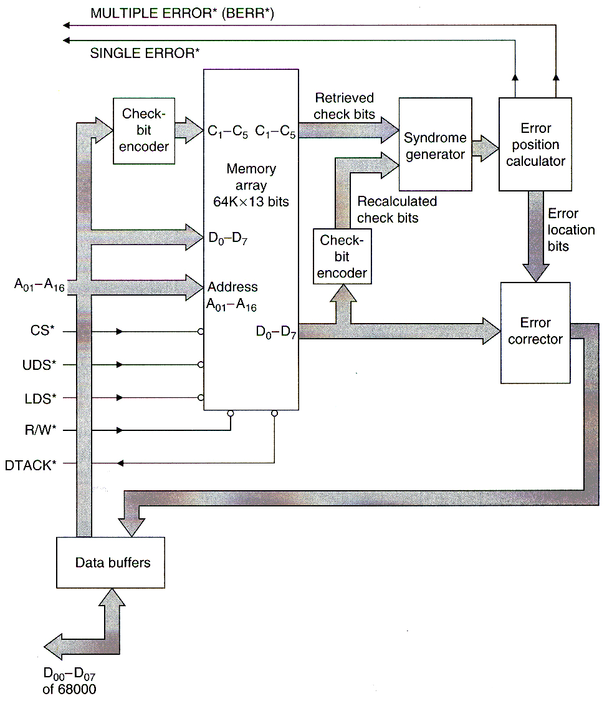
Exceptions to inform OS
Example SEC/DED ECC Circuit
The illustration opposite (taken from the book by A.Clements) shows the block diagram of a typical error detection and correction circuit for a byte wide memory array.
Questions to think about
What about protecting 16 bit data. What are the issues here given that the 68k can write a byte or a word to memory?
What advantage is there to using 64 bit wide memory in the PC?
Parity generator
Check code look up
P₀-P₄
C₀-C₄

Slide 57
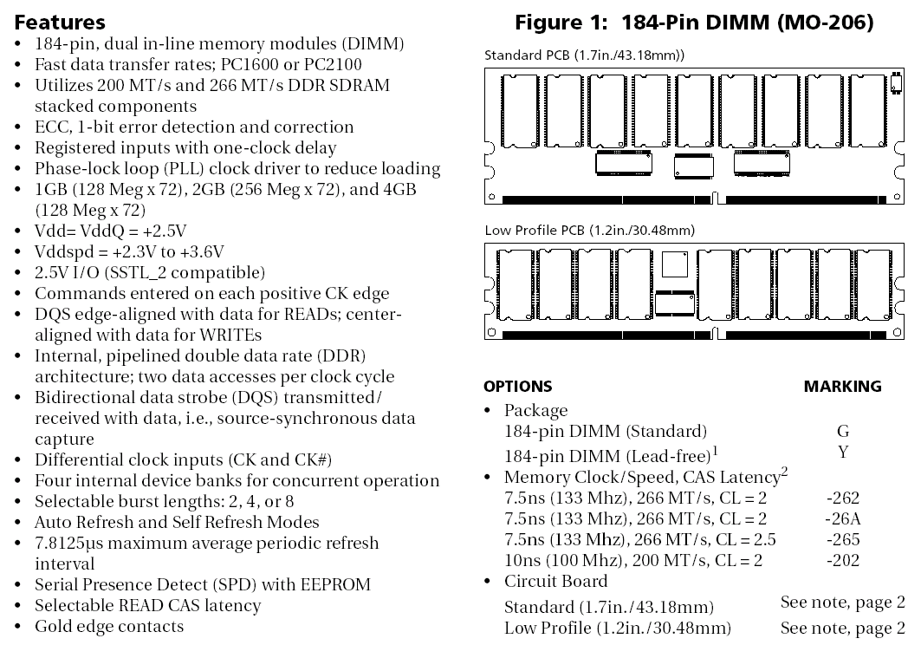
A Typical Micron Memory Module with support for DED/SEC ECC: 64 data bits, 8 Check Bits

Slide 58
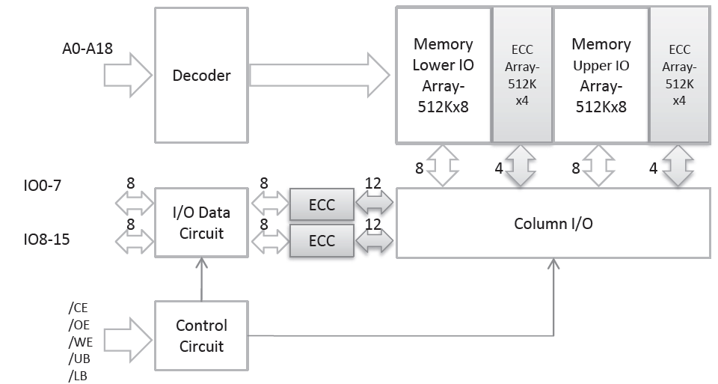
SED/SEC Schemes with Sram and Flash
More and more manufacturers are offering built in ECC for many of their Memory chips, e.g. the ISSI IS61WV51216EDALL 512K word Sram used on the DE2 board.
You can see much of what has been discussed in this lecture reflected in the architecture of that chip shown below. The ECC circuitry and extra parity bits for SED/SEC are built entirely into the chip.
Question: Why are there 2 sets of ECC circuity and 2 sets of arrays of 4 parity bits? Page 23 suggests only 5 parity bits would be required

Slide 59
Memory Scrubbing
Because the likelihood of “soft errors” arising increases with time, there is a very slight risk that single bit correctable errors could develop into multi-bit non-correctable errors within the same location.
To combat this, some operating systems, run a background (idle) task called a “memory scrubber”. This low priority task reads data from each memory location and detects where single bit errors have occurred and writes back the corrected data, thus removing the single bit error and reducing the risk of it developing into a double bit error.
If you think about it, this is something that could actually be built into a Dram controller. The downside to scrubbing is the increased power consumption due to the increased memory activity.
See https://en.wikipedia.org/wiki/Memory_scrubbing

Slide 60
Discussion Problem:
Suppose we wanted to add a SED/SEC scheme to our 256k Sram memory for use on the DE1.
Given what you know about the 68k can you think of a way it could be done with an Sram controller circuit?
How many parity bits would be needed? What would be the equations?
How would you get the Sram controller to correct single bit errors?
Example Problem
On canvas (under topic 5) is a sample tutorial problem set to help you with checking your understanding on this topic.

